Slide 1

Distinguishing Python
Kristine Middlemiss, Senior Developer Consultant
Autodesk Developer Network (ADN)

Slide 2
Session Agenda
Working with Modules
Utilities functions
Maya Standalone
Python and MEL Scripting
Docs are written for C++
Differences between C++ and Python API

Slide 3

Working with Modules
Navigating the Maya Python namespace

Slide 4
Maya Python Modules
maya | Top-level module
maya.cmds | Maya commands (e.g. sphere, getAttr) and plug-in commands
maya.OpenMaya* | OpenMaya API modules
maya.utils | Utilities not specific to API or Maya commands
maya.standalone | Initialization routine for standalone Python
maya.app | Python code used to implement Maya
maya.mel.eval() | Runs MEL commands as a string
maya.stringTable | This is the strings used to built the UI, for localization

Slide 5
Python Modules
All Python functionality in contained in modules
Modules may have hierarchy (e.g os.path)
Import modules to access them
import maya.cmds
maya.cmds.sphere()
import maya.cmds as cmds
cmds.sphere()
from maya.cmds import *
sphere()

Slide 6
Importing Modules
There are three forms of import:
Import a module using full namespace
Import a module using full namespace, but choose a new name
Import an item from anther module into your global namespace

Slide 7
Using Modules
To use a module in your code, use “import”
“import” adds a module to the namespace of your code
“import” searches sys.path
Similar to “source” in MEL

Slide 8
Script Modules
Module is used to define closely related functionality
Use Python "import" command to bring in modules
import myModule
myModule.myFunction()
# Result: 1 #
reload" command updates module:
reload( myModule )
Module must be available in path

Slide 9
Python Path
PYTHONPATH environment variable
Read when Python initializes
Stored in sys.path
sys.path
Can be modified after Python is initialized

Slide 10
Scripts Path
PYTHONPATH defines search path for scripts
Includes standard Maya script paths
Update at startup via Maya.env file
Update from Python:
import sys
sys.path.append( "C:/scripts" )

Slide 11
Maya Environment Variable
Text file: Maya.env
Recommended approach of setting environment variable
Syntax:
PYTHONPATH = C:\Users\wengn\Documents\test
Save it to
C:\Users\wengn\Documents\maya\2012\Maya.env

Slide 12
Config File
Create a userConfig.py file and add it to somewhere on your path (PYTHONPATH)
You can add imports and whatever
Changes will show up in top level context
import maya.cmds as cmds

Slide 13
Other Useful Modules (externally)
os | process management, environment variables, etc
os.path | file path routines: join, split, etc.
sys | shell arguments (argv), python globals
re | regular expressions
urllib2 | URL access
pickle | object archiving
getopt | command line argument parsing
math | assorted math routines and constants

Slide 14
Utility Functions

Slide 15
Utility Functions
maya.utils
Utilities that are not API or Command specific are located in maya.utils
Only two functions there so far
maya.utils.executeInMainThreadWithResult()
maya.utils.processIdleEvents()

Slide 16
Utility Functions
maya.utils.executeInMainThreadWithResult
executeInMainThreadWithResult allows other threads to call Maya routines which are not thread safe
It only works from the GUI app as it uses idle events
Thread blocks until main thread completes execution
Any result or exception is passed to the calling thread

Slide 17
Utility Functions
maya.utils.executeInMainThreadWithResult
executeInMainThreadWithResult can accept either a string to evaluate or a Python function
def myProc():
return maya.cmds.ls()
res = maya.utils.executeInMainThread( myProc )

Slide 18
Utility Functions
maya.utils.processIdleEvents
maya.utils.processIdleEvents() is mainly used for testing
It tells the idle queue to process existing idle events
Returns True if all items on the idle queue were processed

Slide 19
Maya Standalone

Slide 20
Importing Maya into external interpreter
Maya modules can be used within an external Python interpreter as long as:
version numbers match well enough
environment is correct
Maya ships with a “python” command in the bin directory of the distribution
Included “python” command sets up correct environment and runs Maya’s version of Python

Slide 21
Initialization
Using Maya in a standalone Python interpreter is similar to writing a library mode app using the API
Maya must be initialized before Maya’s Python APIs are used
Initialization is done as follows
Initialization takes a while to run
import maya.standalone
maya.standalone.initialize( name=’python’ )

Slide 22
Python & MEL Scripting

Slide 23
Maya Python Scripts
All "Maya Commands" (previously called "MEL Commands") now accessible from Python
Exposed through the maya.cmds module:
MEL:
select pCube1;
ls –sl;
Python:
import maya.cmds
maya.cmds.select( “pCube1“ )
maya.cmds.ls( sl=True )

Slide 24
Python vs. MEL
Use a good text editor and don’t mix tabs and spaces
Tabs are 8 spaces by default
You must explicitly import all external code
No auto finding of global functions
Global scope has a different definition in both languages
All object names must be quoted
Booleans in Python are “True” and “False” capitalized
Importing a module again does not reload it
Use reload command instead (i.e. reload(maya.test.UtilsTest))
Use PYTHONPATH instead of MAYA_SCRIPT_PATH

Slide 25
Interoperability between scripting languages
Python can call MEL and MEL can call Python
New Python scripts must hook into existing MEL-based UI

Slide 26
MEL to Python
MEL has a new “python” command that can be used to call into Python
Takes a string containing Python code
Returns the result of the computation
Basic Python types are converted into matching MEL type (e.g.strings, ints, lists of ints, etc.)
All other types are converted into their string representation
import myModule
$result = python( “myModule.myMelProc()” )

Slide 27
Python to MEL
Python has maya.mel() function, which is possibly
moving to maya.cmds.mel()
Takes a string containing MEL code
Returns the result of the computation
All MEL return values are converted into a logical Python value
result = maya.mel( “myMelProc()” )

Slide 28
Python/MEL communication
Invoke MEL from Python:
import maya.mel
maya.mel.eval( "ls -sl" )
# Result: ['pSphere1'] #
Invoke Python from MEL:
“python” command
string $foo[] = python( "['a','b','c']" );
size($foo);
// Result: 3 //

Slide 29
Python/MEL communication
Accessing Python information from MEL
Python:
class MyFile:
_f = "mytestfile.txt"
mf = MyFile()
MEL:
string $f = python("mf._f");
print $f;

Slide 30
Docs are written for C++

Slide 31
Python API Documentation
No Python-specific API class documentation
Methods not supported in Python:
Marked by: NO SCRIPT SUPPORT
In most cases, alternate forms are provided

Slide 32
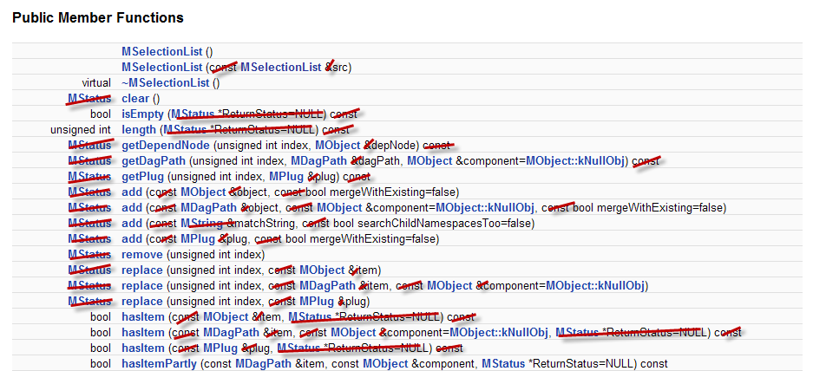
C++ Learning Curve in Docs

Slide 33
Differences between C++ and Python API

Slide 34
Maya Python API Plug-ins
Several modules were constructed that expose most of the C++ API functionality:
OpenMaya.pyc
OpenMayaAnim.pyc
OpenMayaRender.pyc
OpenMayaUI.pyc
OpenMayaMPx.pyc
OpenMayaCloth.pyc
Notes:
Start of section (2)Maya Python API plugins

Slide 35
OpenMaya Key Points
Parellels C++ libraries, except for maya.OpenMayaMPx
All MPx proxy classes are collected into maya.OpenMayaMPx for technical reasons.
Python API is a thin wrapper around C++ API
Full support of C++ Maya API functionality
SWIG based bindings created from header files
Modules: $MAYA_LOCATION/Python/lib/site-packages/maya

Slide 36
Python API Scripts: Example
Most code translates readily from C++ to Python
# DG modifier to change perspective camera translateX
import maya.OpenMaya as om
sel = om.MSelectionList()
om.MGlobal.getSelectionListByName( "persp“, sel )
dagPath = om.MDagPath()
sel.getDagPath( 0, dagPath )
dagPath.fullPathName()
# Result: |persp #
mod = om.MDGModifier()
mod.commandToExecute( "setAttr persp.tx 5" )
mod.doIt()
maya.cmds.getAttr( "persp.tx" )
# Result: 5 #
mod.undoIt()
# Result: 28 #

Slide 37
Python API vs. C++ API
No MStatus class - use exceptions instead
try:
fnPlugin.registerCommand( “spLs", cmdCreator )
except:
sys.stderr.write( "Command registration failed")
raise
Catch error if registerCommand() fails

Slide 38
Python API vs. C++ API
Detect error but allow code to keep running
try:
fnPlugin.registerCommand( “spLs", cmdCreator )
except:
sys.stderr.write( "Command registration failed")
pass
Keyword pass used instead of raise

Slide 39
Python API vs. C++ API
MString and MStringArray classes have been replaced by Python native strings and string lists
import maya.OpenMaya as om
sel = om.MSelectionList();
om.MGlobal.getSelectionListByName( "persp", sel )
path = om.MDagPath()
sel.getDagPath(0, path )
myString = path.fullPathName()
print "Path is %s" % myString
# Path is |persp #
myStrings = []
sel.getSelectionStrings( myStrings )
print myStrings
# [u'persp'] #

Slide 40
Python API vs. C++ API
Python does not have a concept of pointers
Use MScriptUtils for working with pointers and references
Reference treated as a pointer
MScriptUtils
creates objects that can be passed as pointer or reference parameters
convenience methods for transferring values between these objects and native Python datatypes

Slide 41
Python API vs. C++ API
(C++) int MImage::getSize( unsigned int& width, unsigned int& height )
(Python)
img = OpenMaya.MImage()
img.create( 512, 256 )
util = OpenMaya.MScriptUtil()
util2 = OpenMaya.MScriptUtil()
wPtr = util.asUintPtr() # creates a ptr object
hPtr = util2.asUintPtr() # creates another ptr object
OpenMaya.MScriptUtil.setUint( wPtr, 0 )
OpenMaya.MScriptUtil.setUint( hPtr, 0 )
img.getSize( wPtr, hPtr )
width = OpenMaya.MScriptUtil.getUint( wPtr ) # 512
height = OpenMaya.MScriptUtil.getUint( hPtr ) # 256

Slide 42
Python API vs. C++ API
MPxCommand has to use MSyntax
In C++, it is possible to use the argument parameter (MArgList) of MPxCommand::doIt() to parse arguments.
In Python, you must use the MSyntax and MArgParser classes to support arguments within a scripted MPxCommand.

Slide 43
Python API Scripts: Caveats
Careful about undo
API functionality is not automatically undoable in the same way that MEL commands are
With Python API code operating outside of an MPxCommand-derived class, there is no formal interface to allow you to implement your own undo behaviour
Careful with scripted plug-ins
Importing the .py file is not the same as loading it from the Plug-in Manager
Will not register new commands/nodes

Slide 44
Autodesk

